Slide 1
Federal University of Rio de Janeiro www.ufrj.br

Slide 2
Higher Education in Brazil

Slide 3
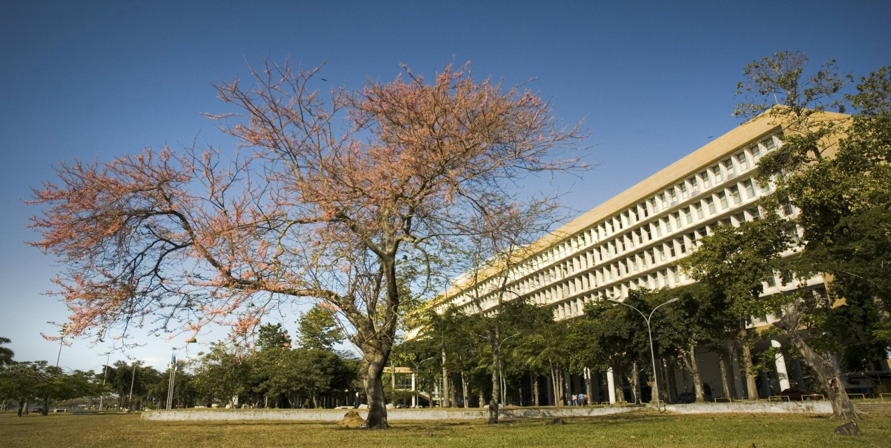
Federal University of Rio de Janeiro
Created in 1920 by the union of 3 schools: the Medical School (1808), the Polytechnic School (1810), and the Law School (1891). By then it was called Universidade do Rio de Janeiro;
Reorganized in 1937 as University of Brazil. There were 15 faculties then.
Named Universidade Federal do Rio de Janeiro (Federal University of Rio de Janeiro) in 1967.

Slide 4
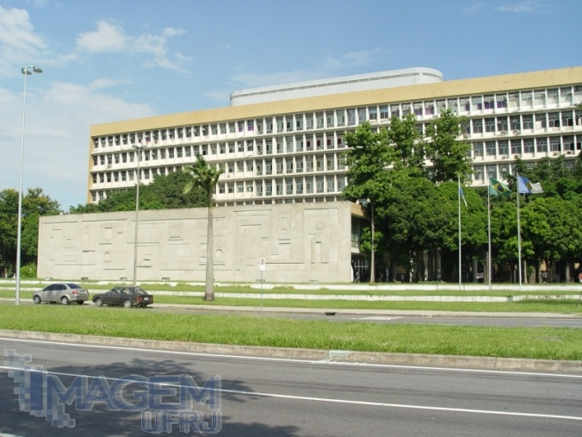
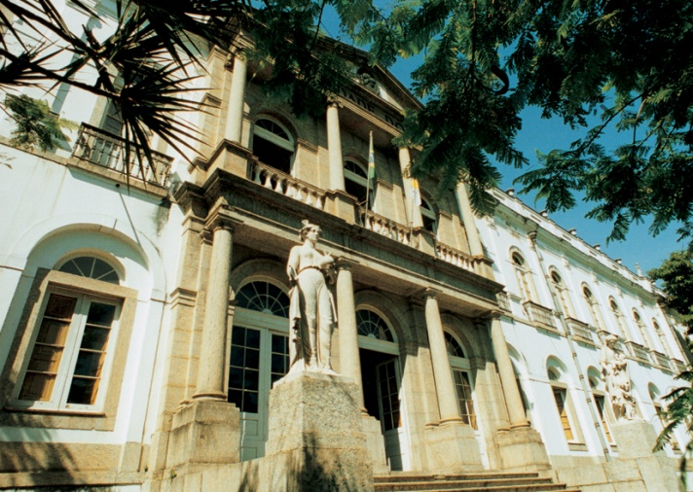
Rankings
World Ranking #284
Latin American Ranking #8
Brazilian Ranking #3

Slide 5
Rankings
Alma Mater Index:
Global Executives #62
The Times Higher Education Alma Mater Index: Global Executives 2013 ranks institutions by the number of degrees they have awarded to the top executives of Fortune Global 500 companies.

Slide 6
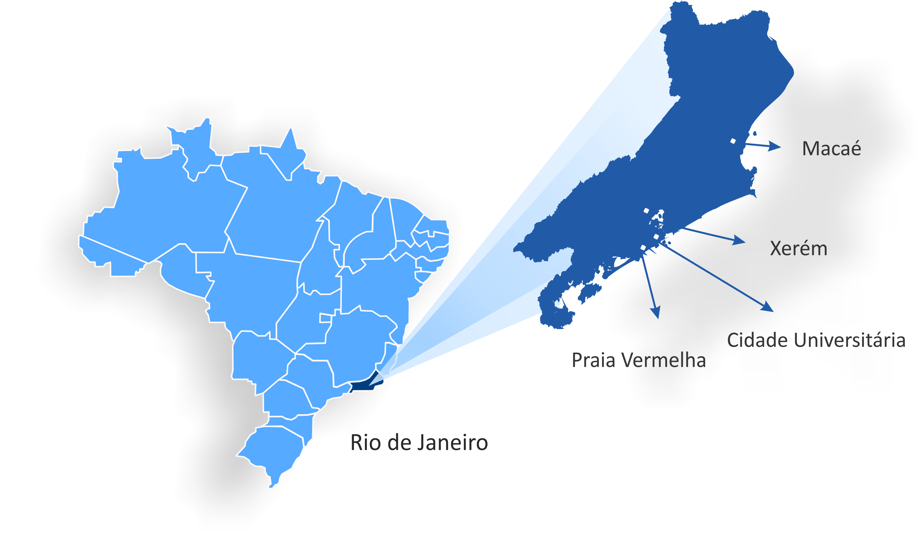
The UFRJ Campuses

Slide 7
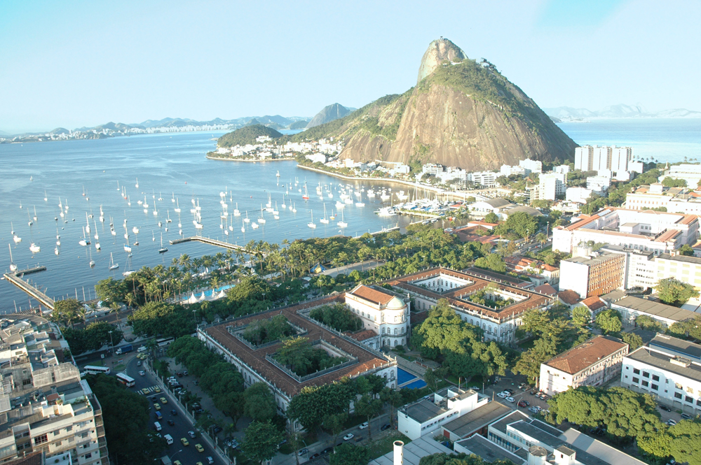
Praia Vermelha
The university’s oldest campus. It was originally a hospital for the mentally ill and in 1949 the space was donated to the UFRJ. It is placed near one of the postcards of Rio de Janeiro, the Sugarloaf, in one of the most beautiful sites of the city. Several units of the Center of Juridical and Economic Sciences (CCJE) and of the Center of Philosophy and Human Sciences (CFCH) are placed in this campus.

Slide 8
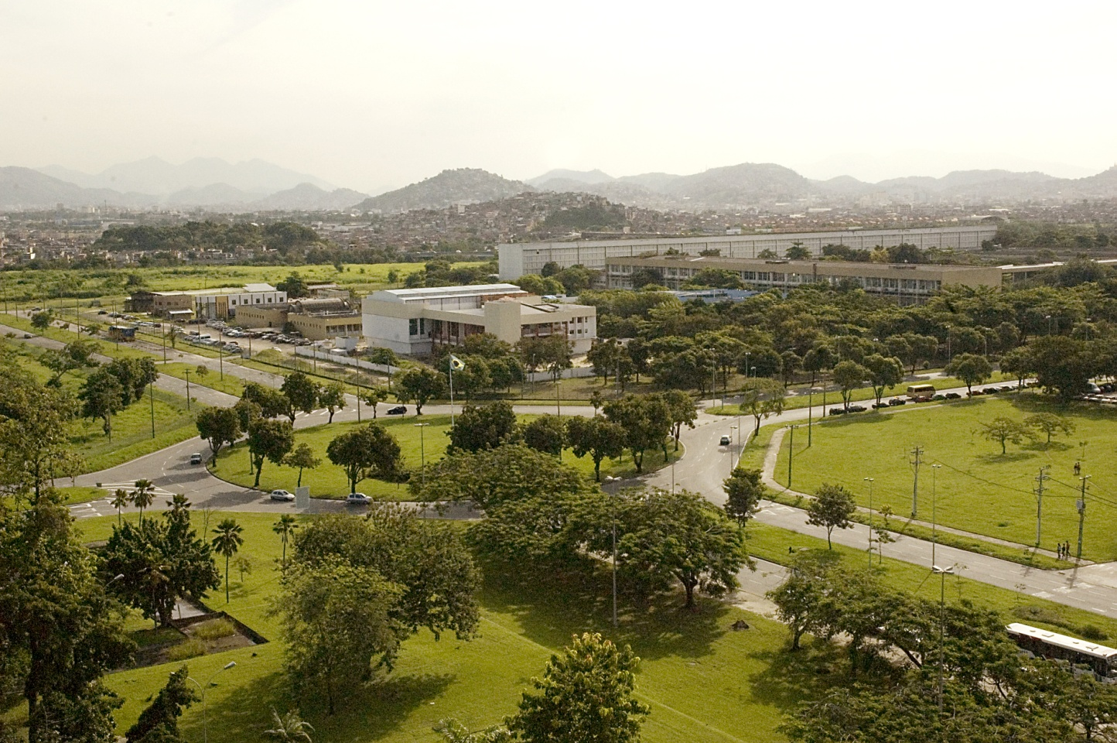
Cidade Universitária
Artificial island created in the 50’s by land reclamation;
The largest UFRJ campus (5.238.337,87m2);
Also known as Campus do Fundão;
Comprises most of the faculties and academic units of the university.

Slide 9
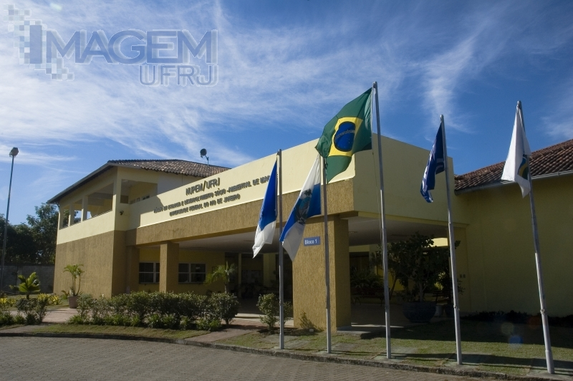
Macaé
A city considered the center of the offshore oil industry in Brazil. Several facilities of Petrobras are established there;
The Macaé campus hosts courses in the Biomedical and Technological fields of enquiry.

Slide 10
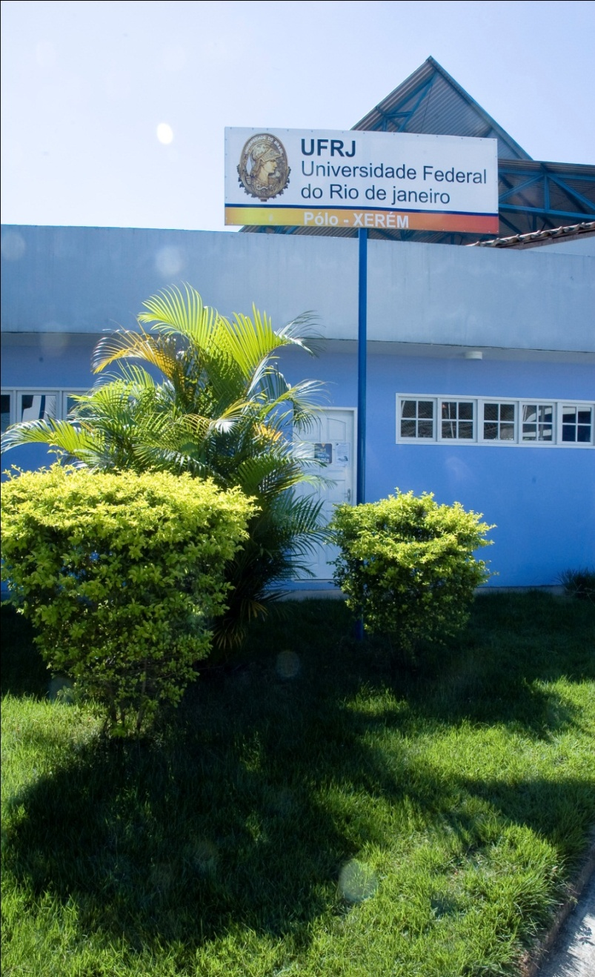
Advanced Complex of Xerém
The advanced complex of Xerém was established in 2008 and hosts the following courses:
Biological Sciences
Biotechnology
Biophysics
Nanotechnology.
Advanced Complex of Xerém

Slide 11
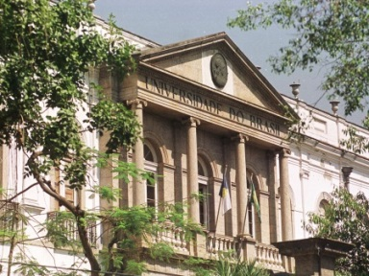
indicators
+ 180 undergraduate courses
+ 100 graduate programs
+ 100 extension projects
Hosted by the following Centers:
Center of Mathematics and Natural Sciences
Center of Letters and Arts
Center of Philosophy and Human Sciences
Center of Juridical and Economic Sciences
Center of Health Sciences
Center of Technology

Slide 12
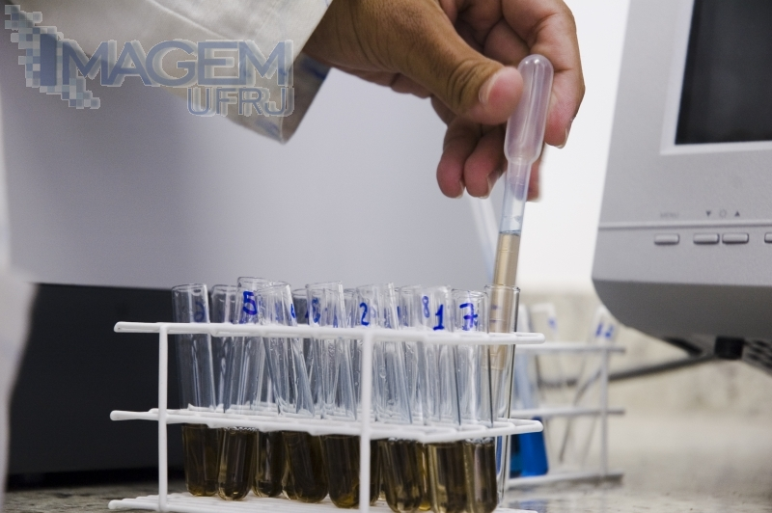
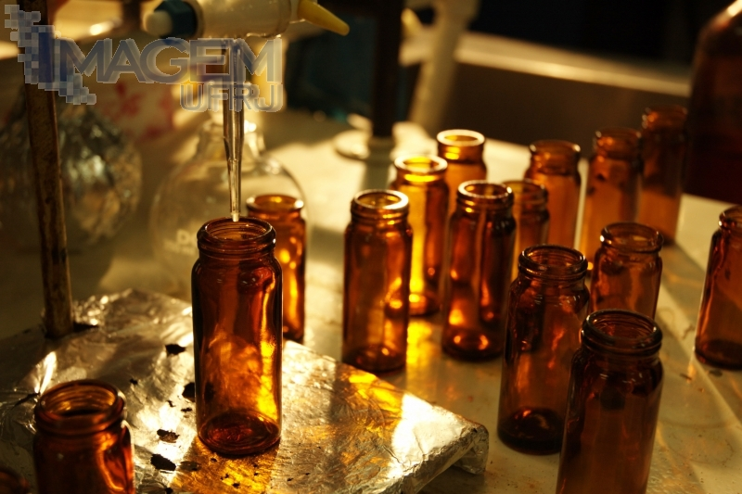
Indicators
Undergraduate Studies
Undergraduate Courses | 181
Enrolled Students | 51.662
Enrolled Distance Education Students | 6.372
Scholarships | 6.181
UFRJ vagas | 9.150

Slide 13
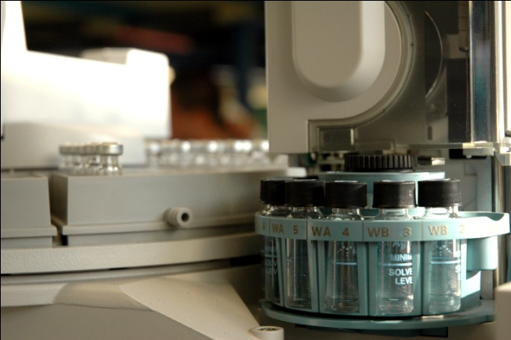
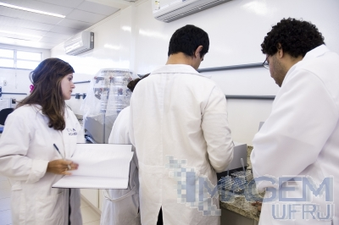
Indicators
Graduate Studies
Programs | 104
Sensu Lato (Certificate Courses) | 315
Strictu Sensu Courses | 168
Master’s | 90
Professional Master’s | 13
Doctorate | 83
Enrolled Students | 11.290
Master’s | 5.941
Professional Master’s | 318
Doctorate | 5.349
Graduate Scholarships
Master’s | 2.526
Doctorate | 2.617
Capes Evaluation (2010)
3 and 4 | 36
5 | 22
6 and 7 | 25
Extension
Programs | 15
Projects | 112
Classroom-based Courses | 110
Distance Education Courses | 6
Reached Public | 1.036.990

Slide 14
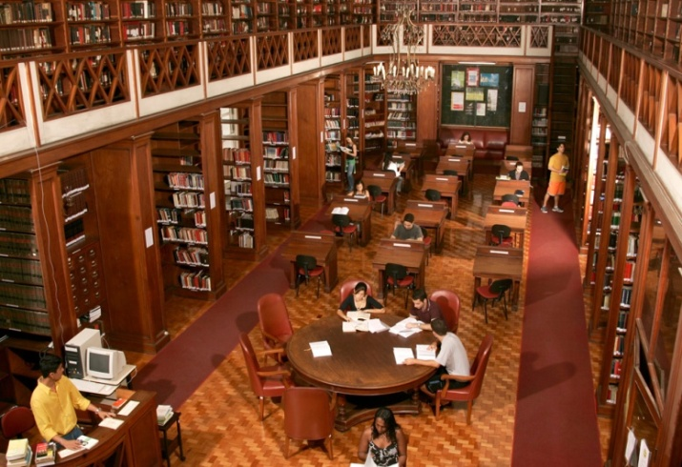
Offers the Students
Free acess to research platforms and databases (e.g):
42 libraries with more than 1.000.000 titles;
SIBI – The Ufrj Library and Information System
Law School

Slide 15
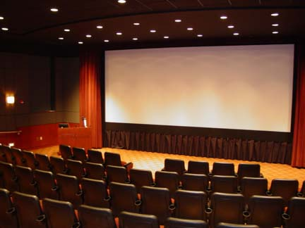
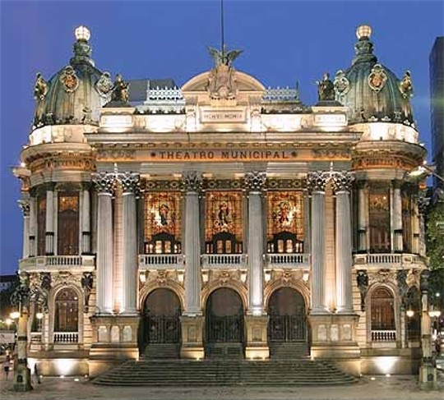
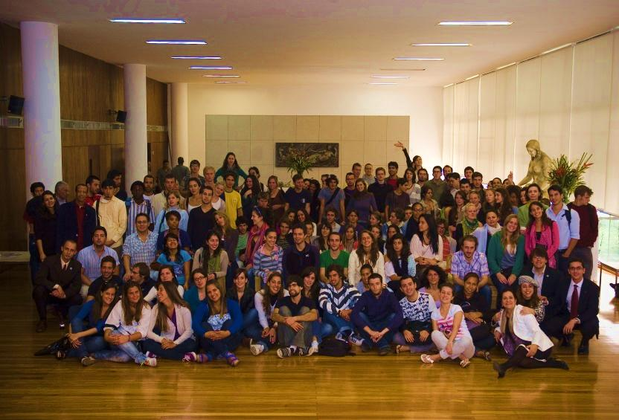
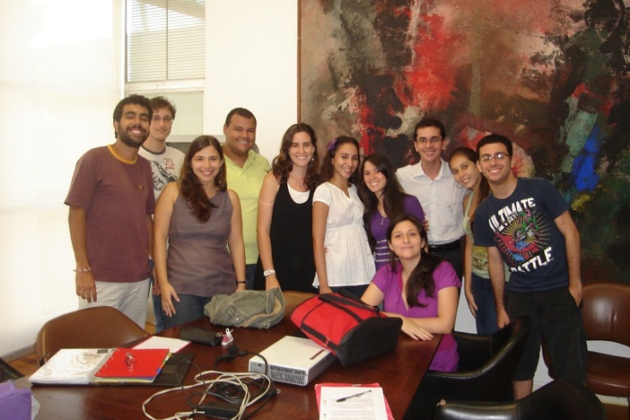
Offers the Students
Student card, which gives the student 50% discount in cultural activities;
50% off in the movie theater
Municial Theater
International exchange with no tuition or fees;
Welcome Ceremony – Foreign Students 2010.2
First UFRJ EBW Schorlarship holders

Slide 16
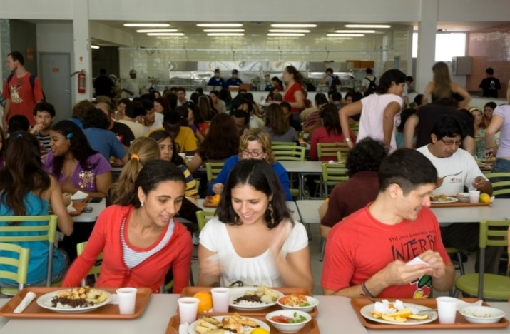
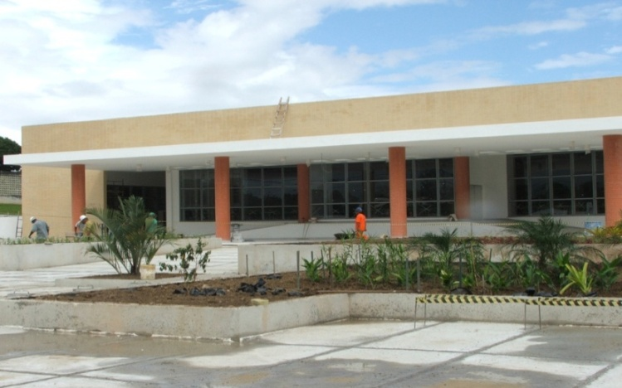
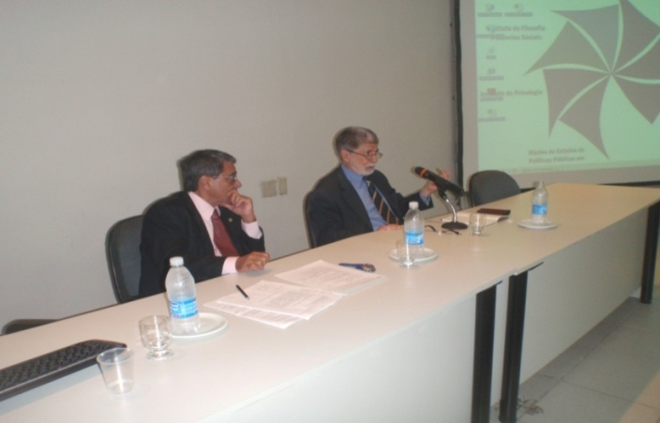
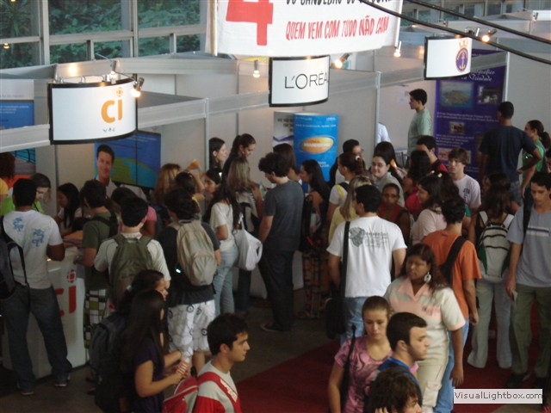
Offers the Students
University Restaurants;
Faculty of Letters university restaurant
School of Physical Education and Sports University Restaurant
Events that bring society and the academic community closer
UFRJ Seminar on Internationalization (Minister of Defense Celso Amorim
Fairs and Internship oportunities.

Slide 17
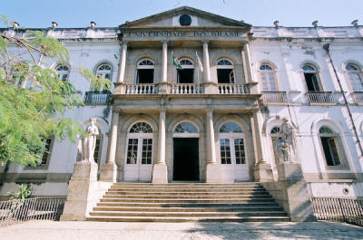
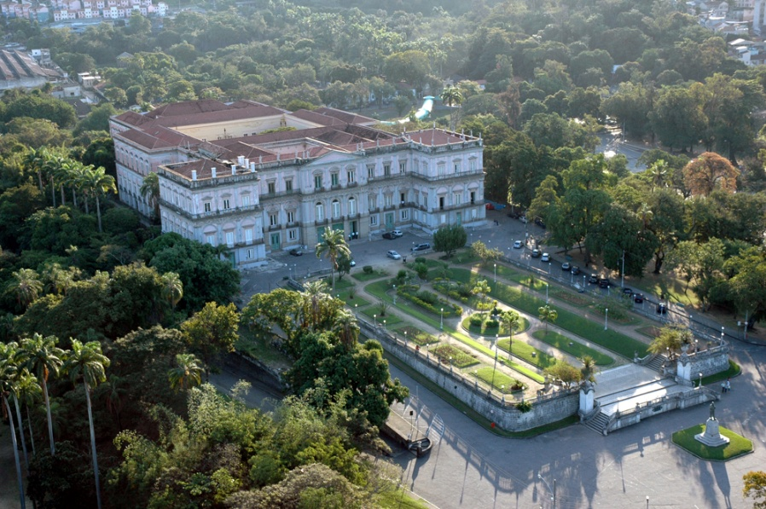
Centers and Units
Forum for Science and Culture
Founded in the 70s;
Head office placed in Palácio Universitário da Praia Vermelha (Praia Vermelha University Palace);
UFRJ cultural site;
Aims at creating an exchange net between academy and society through science, arts, politics and culture fields.
Façade of the UFRJ Science and Culture Forum
National Museum

Slide 18
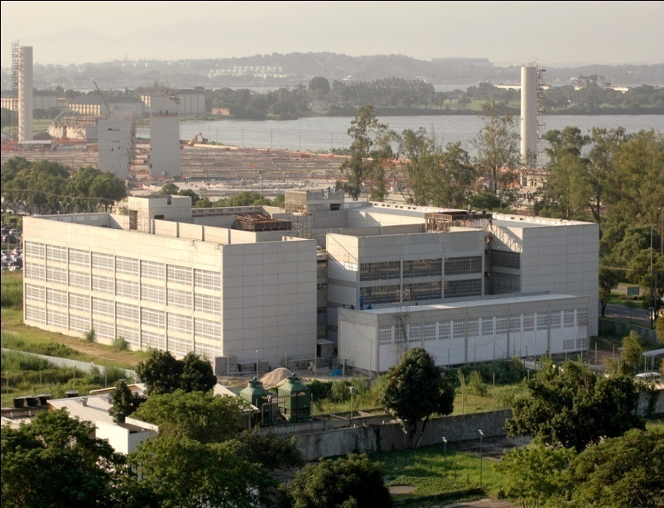
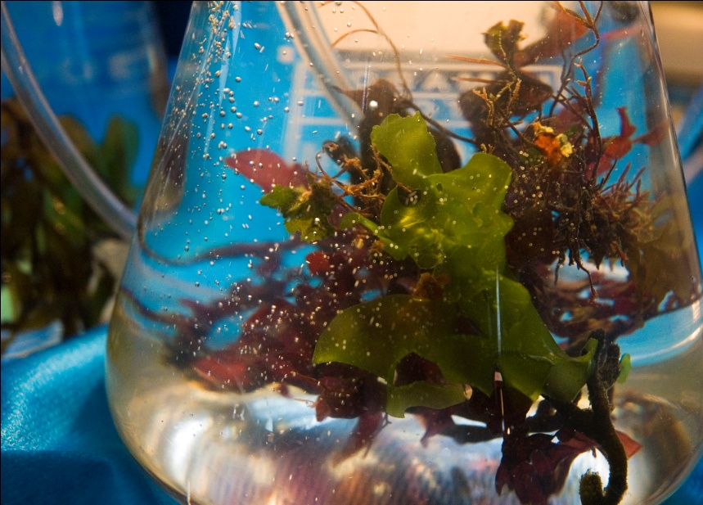
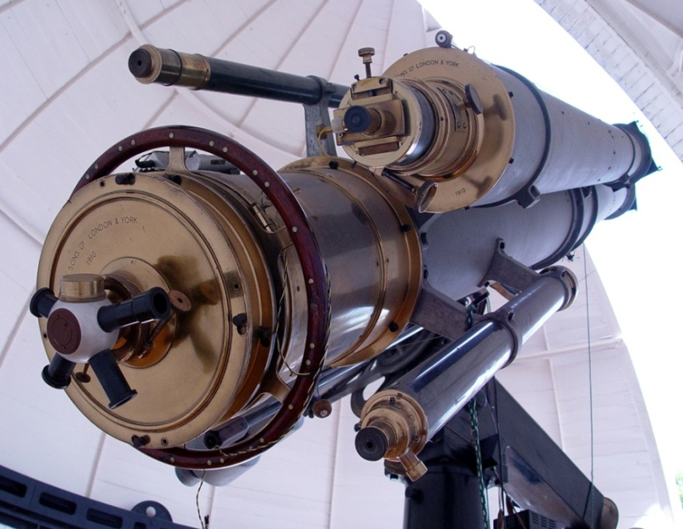
Centers and Units
CCMN – Center of Mathematics and Natural Sciences.
Institute of Mathematics
Institute of Physics
Institute of Chemistry
Institute of Geosciences
Valongo Observatory
Geodiversity Museum
Computer Science Center (NCE)
Institute of Physics
Telescope in the Valongo Observatory

Slide 19
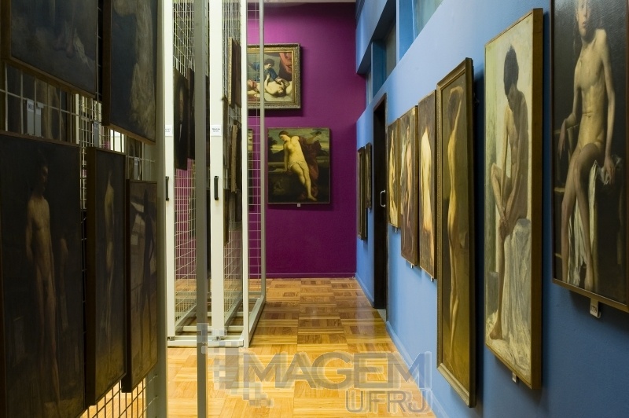
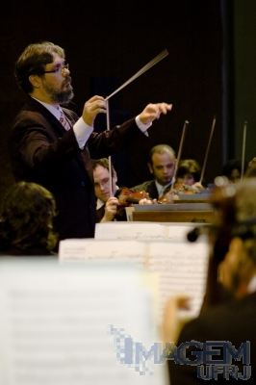
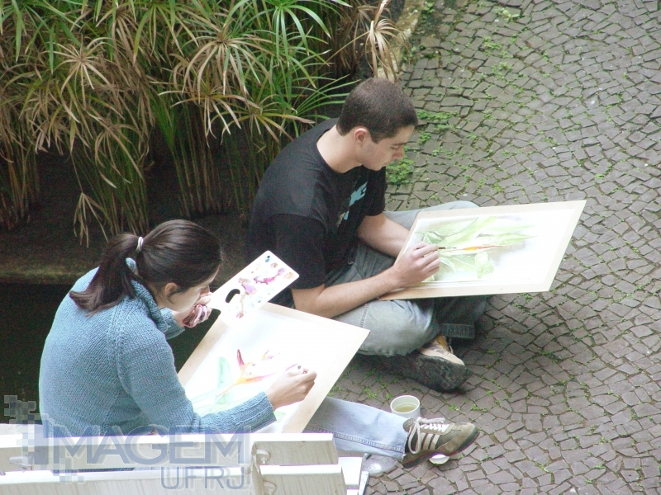
Centers and Units
CLA – Center of Letters and Arts
Faculty of Architecture and Urbanism;
School of Fine Arts;
Faculty of Letters ;
School of Music.

Slide 20
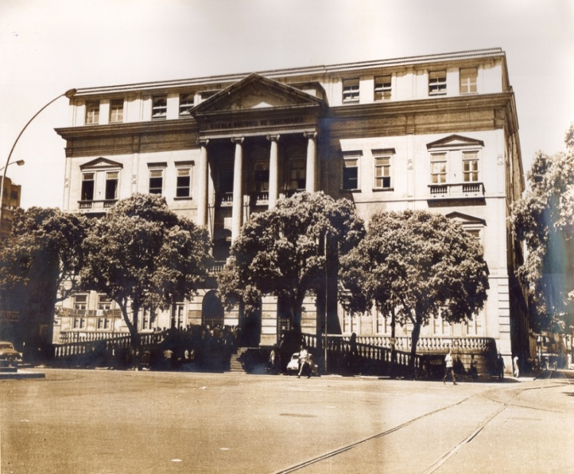
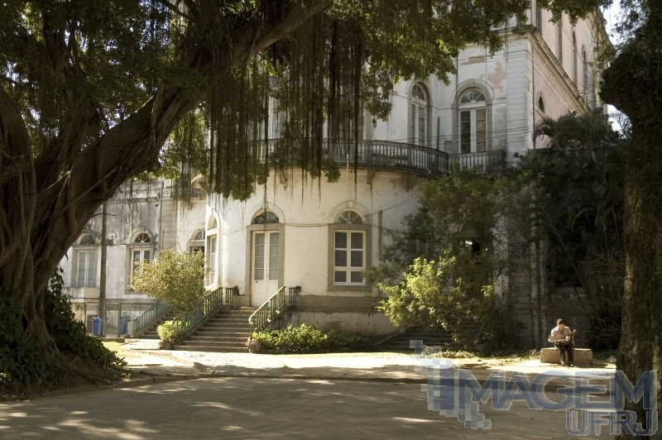
Centers and Units
Center of Philosophy and Human Sciences
School of Communication;
School of Social Work;
Faculty of Education;
Institute of Philosophy and Social Sciences;
Institute of Psychology;
Institute of History;
Cap UFRJ (Laboratory School of UFRJ).
Institute of Philosofy and Social Sciences

Slide 21
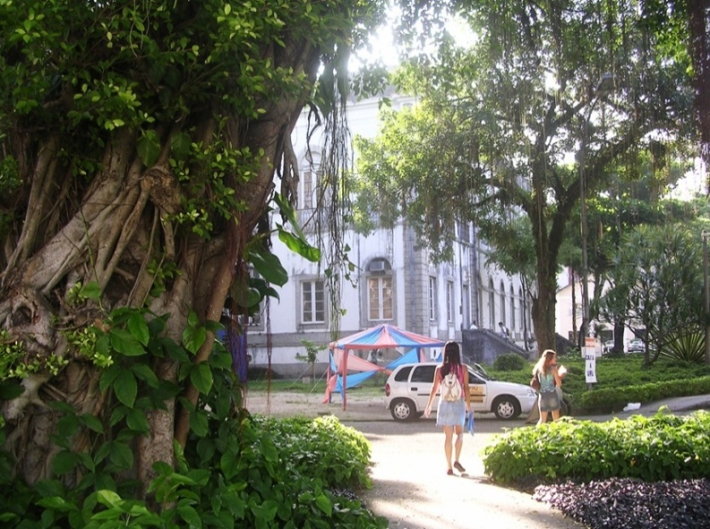
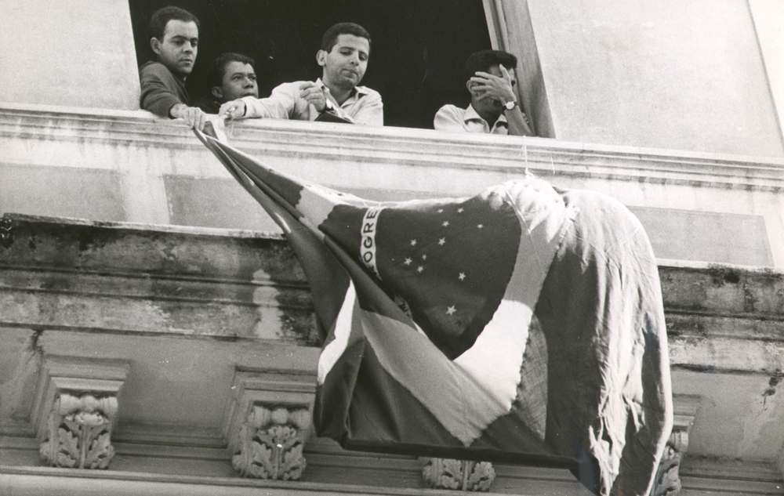
Centers and Units
Center of Juridical and Economic Sciences
Institute of Economics;
Faculty of Law;
Faculty of Management and Accounting Sciences ;
The COPPEAD Graduate School of Business;
IPPUR (Institute for Research and Urban and Regional Planning).
Faculty of Economics
Professors against the dictatorship in the Faculty of Law (1970)

Slide 22
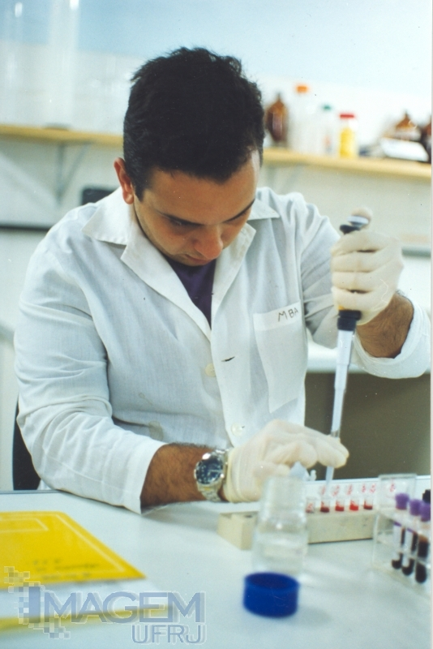
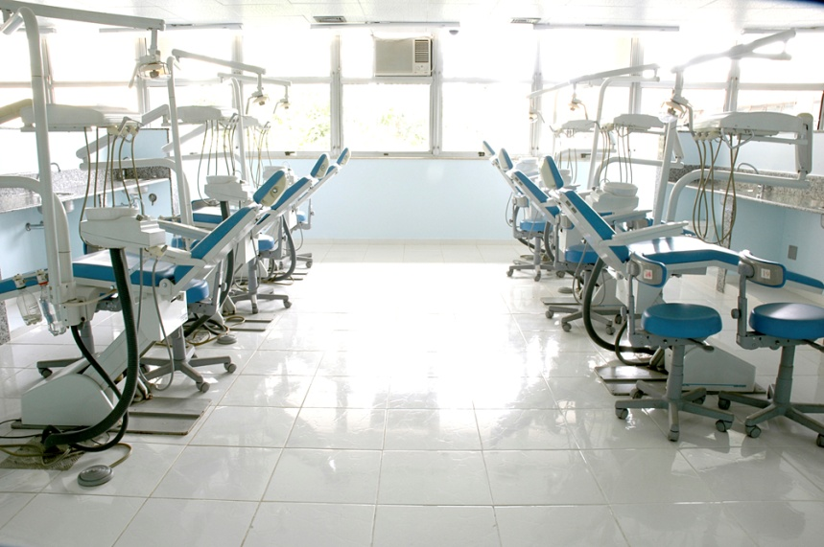
Centers and Units
Center of Health Sciences
Comprises 24 units, including faculties, institutes, and 9 hospitals (e.g.):
Medical School;
Institute of Biomedical Sciences;
Institute of Biology;
Faculty of Odontology;
University Hospital Clementino Fraga Filho.
Prosthesis Clinic

Slide 23
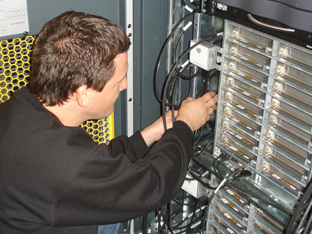
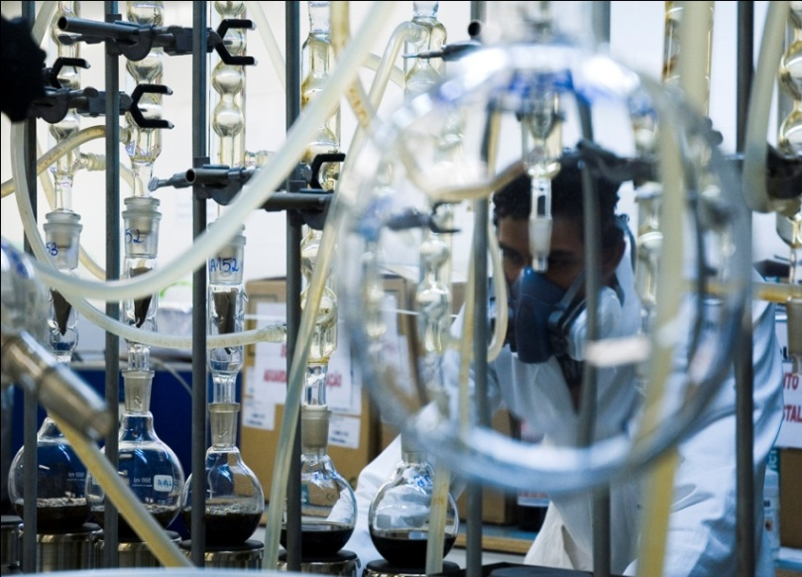
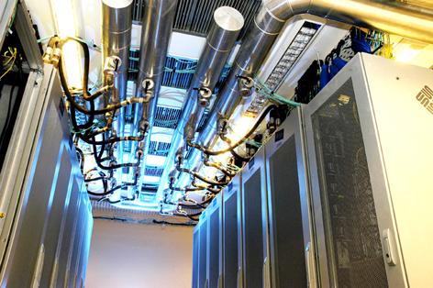
Centers and Units
Center of Technology
Polytechnic School (UFRJ Undergraduate School of Engineering);
School of Chemistry;
Institute of Macromolecules Prof. Eloisa Mano;
COPPE (Alberto Luiz Coimbra Institute – Graduate School and Research in Engineering).
School of Chemistry
Instituto Alberto Luiz Coimbra de Pós-Graduação e Pesquisa em Engenharia

Slide 24
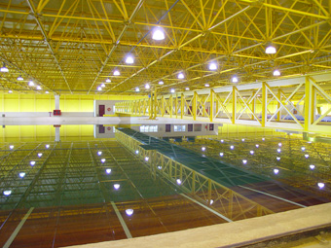
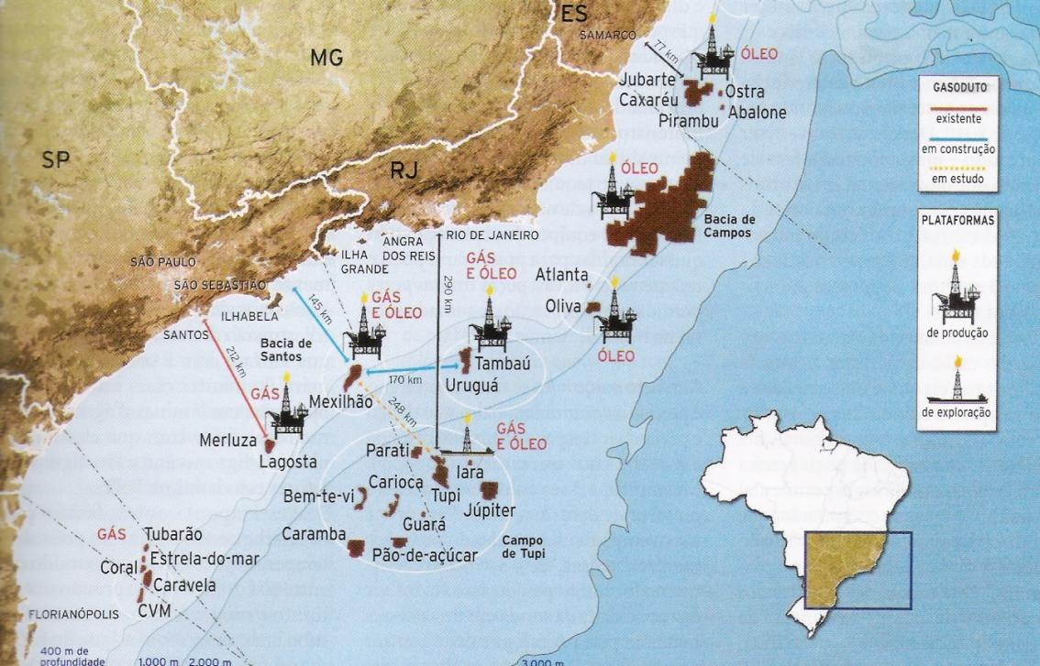
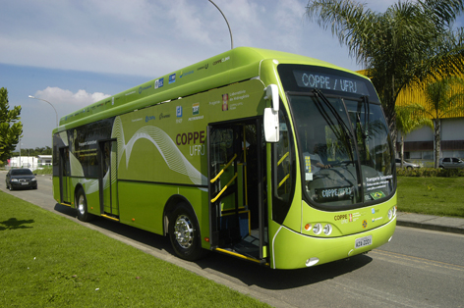
Centers and Units
Ocean Basin
The deepest ocean basin in the world;
Studies, tests and simulation of equipment and structures in profound waters.
Pre-Salt Technologies
Studies and computational simulations for the analysis of tensions around non-conventional wells: wide range wells, horizontal wells, multilateral wells etc.
Hybrid Bus
Capacity: 64 passengers
Fuel Cell (hydrogen) + battery;
Ethanol Engine + Battery;
Battery.

Slide 25
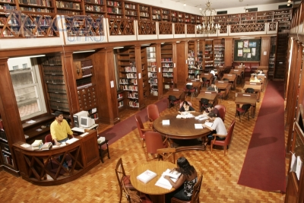
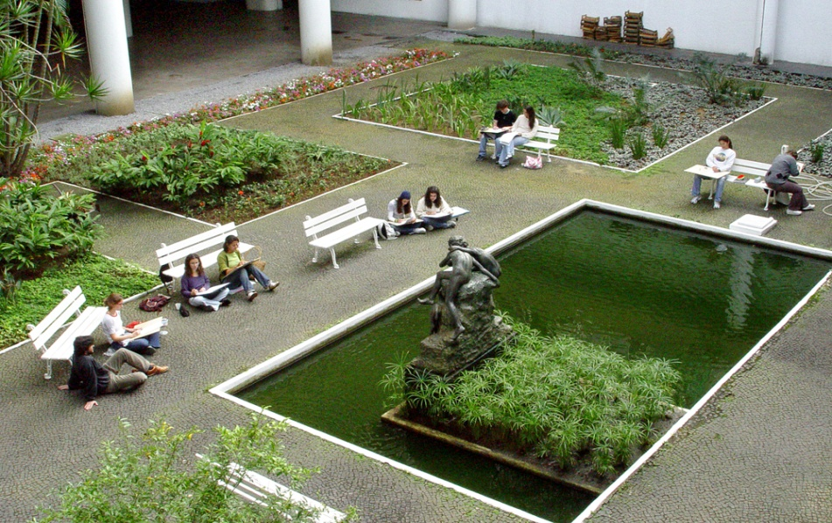
Carvalho de Mendonça Library – Faculty of Law
Garden – FAU/Rectory

Slide 26
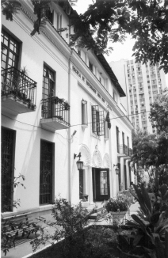
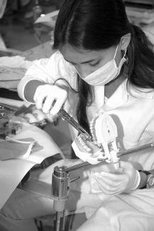
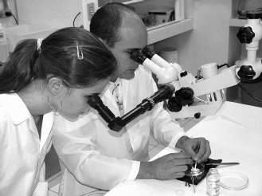
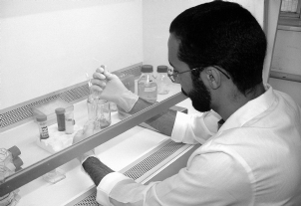
Anna Nery Nursing School
Research at the Odontology Program
The UFRJ takes part in the National Genoma Project

Slide 27
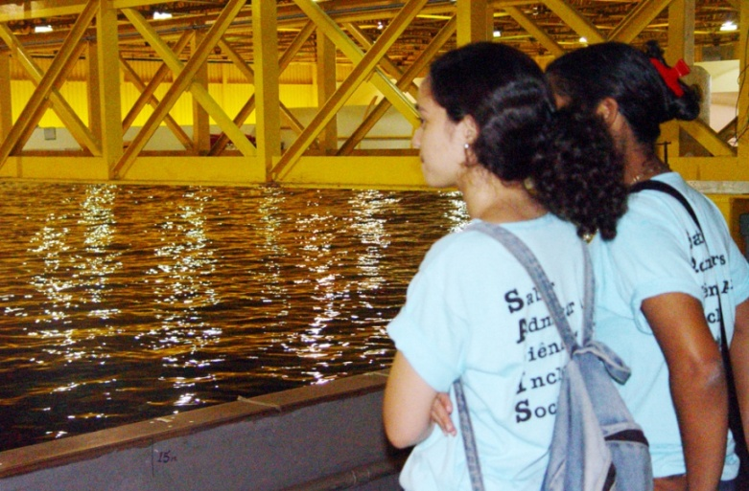
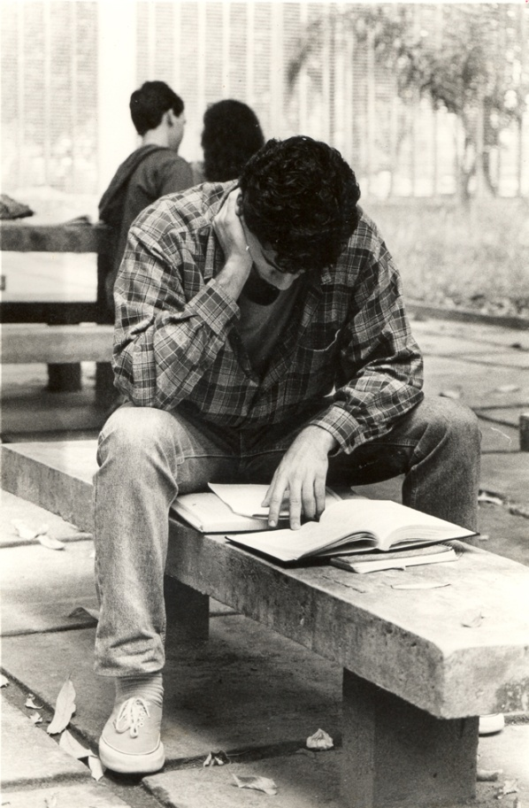
Students at the Ocean Basin
Student in the campus
“Bio na Rua” Project (Bio in the street ): scientific demonstrations downtown Rio de Janeiro

Slide 28
Mobility: +55 21 2598-1610
intercambio@reitoria.ufrj.br
International Affairs: +55 21 2598-1612 / 1618 ri@reitoria.ufrj.br
Agreements :+55 21 2598-1650 convenios@reitoria.ufrj.br

